Slide 1
Relational Database Design
CSC311A - Database Systems
B. Tech. 2014
Course Leader:
Gp Cpt N. Rath VSM
Ami Rai E.

Slide 2
Objectives
At the end of this lecture, student will be able to
explain ER-to-Relational Mapping Algorithm

Slide 3
Topics
ER-to-Relational Mapping Algorithm
Step 1: Mapping of Regular Entity Types
Step 2: Mapping of Weak Entity Types
Step 3: Mapping of Binary 1:1 Relation Types
Step 4: Mapping of Binary 1:N Relationship Types
Step 5: Mapping of Binary M:N Relationship Types
Step 6: Mapping of Multivalued attributes
Step 7: Mapping of N-ary Relationship Types

Slide 4
Conceptual and Logical Design
SID
Name
SSN
Name
Student
Advisor
Professor
Major
Dept
GPA
SID | Name | Major | GPA
1234 | John | CS | 2.8
5678 | Mary | EE | 3.6
SSN | Name | Dept
9999 | Smith | Math
8888 | Lee | CS

Slide 5
Mapping an E-R Diagram to a Relational Schema
We cannot store data in an ER schema
(there are no ER database management systems)
We have to translate our ER schema
into a relational schema
What does “translation” mean?
Maps
ER schemas to relational schemas

Slide 6
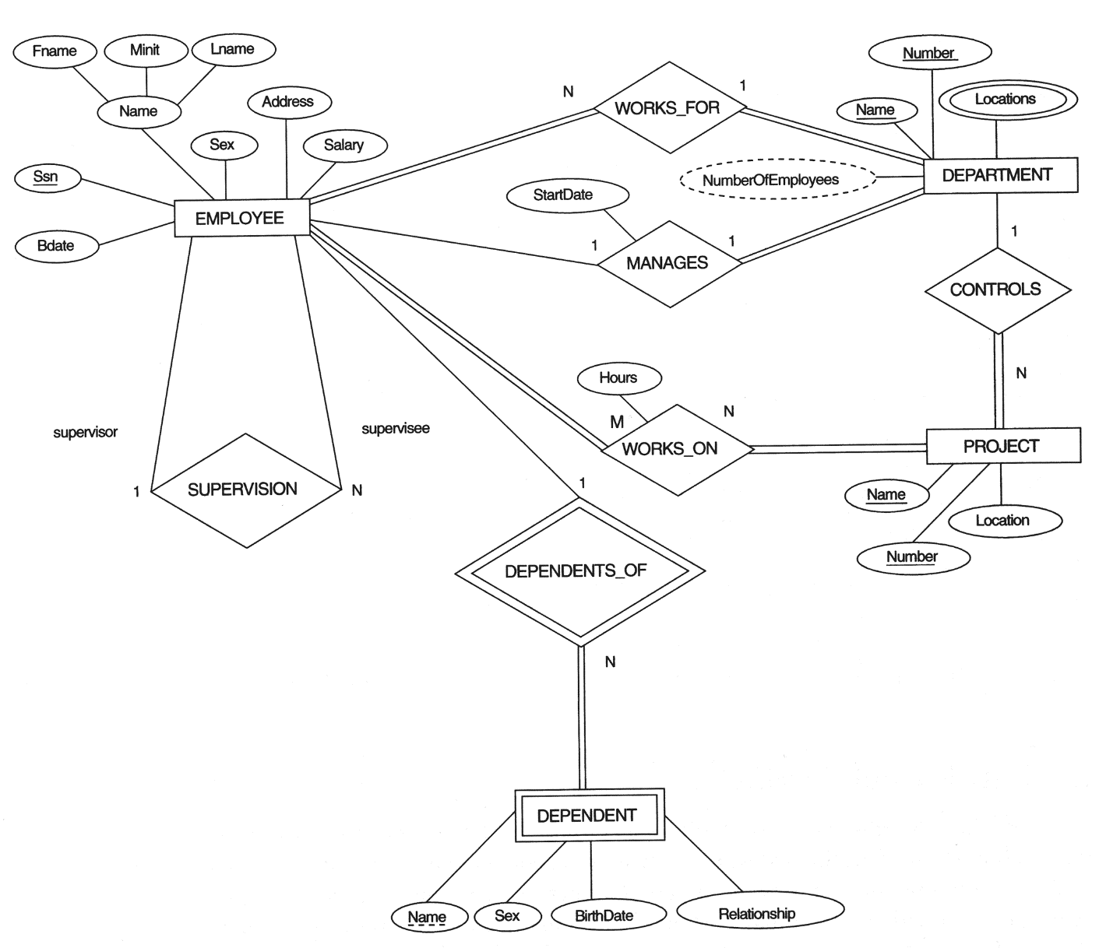
The ER Conceptual Schema Diagram for The COMPANY Database

Slide 7
ER-to-Relational Mapping Algorithm
Step 1: Mapping of Regular Entity Types
For each regular (strong) entity type E in the ER schema, create a relation R that includes all the simple attributes of E
Choose one of the key attributes of E as the primary key for R
If the chosen key of E is composite, the set of simple attributes that form it will together form the primary key of R
Example
Create the relations EMPLOYEE, DEPARTMENT, and PROJECT in the relational schema corresponding to the regular entities in the ER diagram
SSN, DNUMBER, and PNUMBER are the primary keys for the relations EMPLOYEE, DEPARTMENT, and PROJECT as shown

Slide 8
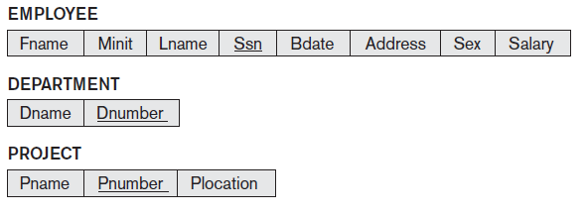
ER-to-Relational Mapping Algorithm
Step 1: Mapping of Regular Entity Types
Entity relations - relations that are created from the mapping of entity types
Entity relation after step 1

Slide 9
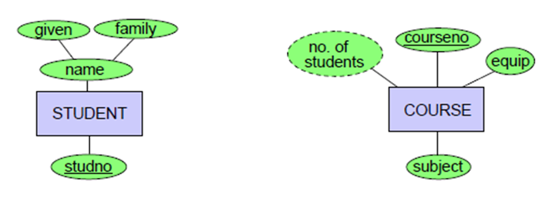
Mapping Entity Types to Relations
Student (studNo, givenName, familyName)
Course (CourseNo, subject, equip)

Slide 10
ER-to-Relational Mapping Algorithm contd.
Step 2 : Mapping of Weak Entity Types
For each weak entity type W in the ER schema with owner entity type E, create a relation R & include all simple attributes (or simple components of composite attributes) of W as attributes of R
Include as foreign key attributes of R, the primary key attribute(s) of the relation(s) that correspond to the owner entity type(s)
The primary key of R is the combination of the primary key(s) of the owner(s) and the partial key of the weak entity type W, if any

Slide 11

ER-to-Relational Mapping Algorithm contd.
Step 2 : Mapping of Weak Entity Types
Example
Create the relation DEPENDENT in this step to correspond to the weak entity type DEPENDENT
Include the primary key SSN of the EMPLOYEE relation as a foreign key attribute of DEPENDENT (renamed to ESSN)
The primary key of the DEPENDENT relation is the combination {ESSN, DEPENDENT_NAME} because DEPENDENT_NAME is the partial key of DEPENDENT
Additional weak entity relation after step 2

Slide 12
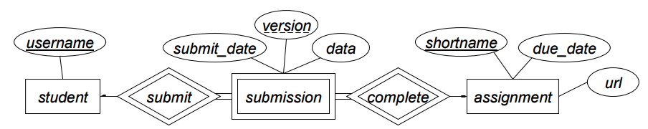
Weak Entity Set - Example
Schemas for strong entity-sets
student (username )
assignment (shortname, due_date, url )
Schema for submission weak entity-set
Both student and assignment are owners
submission (username, shortname, version, submit_date, data )

Slide 13
ER-to-Relational Mapping Algorithm contd.
Step 3 : Mapping of Binary 1:1 Relation Types
For each binary 1:1 relationship type R in the ER schema, identify the relations S and T that correspond to the entity types participating in R
Foreign Key approach
Choose one of the relations S and include as a foreign key in S the primary key of T
It is better to choose an entity type with total participation in R in the role of S
Include all the simple attributes (or simple components of composite attributes) of the 1:1 relationship type R as attributes of S

Slide 14
ER-to-Relational Mapping Algorithm contd.
In our example, we map the 1:1 relationship type MANAGES from the Figure by choosing the participating entity type DEPARTMENT to serve in the role of S because its participation in the MANAGES relationship type is total
Include the primary key of the EMPLOYEE relation as foreign key in the DEPARTMENT relation and rename it Mgr_ssn
Include the simple attribute Start_date of the MANAGES relationship type in the DEPARTMENT relation and rename it Mgr_start_date

Slide 15
ER-to-Relational Mapping Algorithm contd.
Step 4: Mapping of Binary 1:N Relationship Types
For each regular binary 1:N relationship type R, identify the relation S that represent the participating entity type at the N-side of the relationship type
Include as foreign key in S the primary key of the relation T that represents the other entity type participating in R
Include any simple attributes of the relationship as attributes of S
Example
For WORKS_FOR we include the primary key DNUMBER of the DEPARTMENT relation as foreign key in the EMPLOYEE relation and call it DNO
For SUPERVISION we include the primary key of the EMPLOYEE relation as foreign key in the EMPLOYEE relation itself - because the relationship is recursive- call it Super_ssn
The CONTROLS relationship is mapped to the foreign key attribute Dnum of PROJECT, which references the primary key Dnumber of the DEPARTMENT relation

Slide 16
ER-to-Relational Mapping Algorithm contd.
Step 5: Mapping of Binary M:N Relationship Types
For each regular binary M:N relationship type R, create a new relation S to represent R
Include as foreign key attributes in S the primary keys of the relations that represent the participating entity types; their combination will form the primary key of S
Also include any simple attributes of the M:N relationship type (or simple components of composite attributes) as attributes of S

Slide 17

ER-to-Relational Mapping Algorithm contd.
Step 5: Mapping of Binary M:N Relationship Types
Example
The M:N relationship type WORKS_ON from the ER diagram is mapped by creating a relation WORKS_ON in the relational database schema
The primary keys of the PROJECT and EMPLOYEE relations are included as foreign keys in WORKS_ON and renamed PNO and ESSN, respectively
Attribute HOURS in WORKS_ON represents the HOURS attribute of the relation type
The primary key of the WORKS_ON relation is the combination of the foreign key attributes {ESSN, PNO}
Relationship relation after step 5

Slide 18
ER-to-Relational Mapping Algorithm contd.
Step 6: Mapping of Multivalued attributes
For each multivalued attribute A, create a new relation R
This relation R will include an attribute corresponding to A, plus the primary key attribute K-as a foreign key in R-of the relation that represents the entity type of relationship type that has A as an attribute
The primary key of R is the combination of A and K
If the multivalued attribute is composite, we include its simple components

Slide 19

ER-to-Relational Mapping Algorithm contd.
Step 6: Mapping of Multivalued attributes
Example
The relation DEPT_LOCATIONS is created
The attribute DLOCATION represents the multivalued attribute LOCATIONS of DEPARTMENT, while DNUMBER - as foreign key - represents the primary key of the DEPARTMENT relation
The primary key of R is the combination of {DNUMBER, DLOCATION}
Relation representing multivalued attribute after step 6

Slide 20
Multivalued Attribute - Example
SID
Name
The primary key for this table is Student_SID + Children, the union of all attributes
Children
Student
Major
GPA
Stud_SID | Children
1234 | Johnson
1234 | Mary
5678 | Bart
5678 | Lisa
5678 | Maggie
SID | Name | Major | GPA
1234 | John | CS | 2.8
5678 | Homer | EE | 3.6

Slide 21
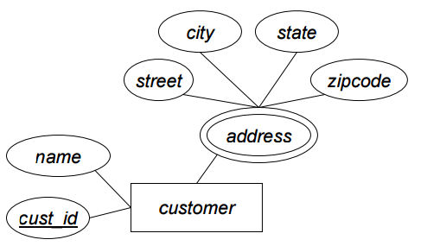
Multivalued Attribute - Example
Customers with multiple addresses
Create separate relation to store each address
customer(cust_id, name )
cust_addrs (cust_id, street, city, state, zipcode )
Large primary keys aren’t ideal – tend to be costly

Slide 22
ER-to-Relational Mapping Algorithm contd.
Step 7: Mapping of N-ary Relationship Types
For each n-ary relationship type R, where n>2, create a new relationship S to represent R
Include as foreign key attributes in S the primary keys of the relations that represent the participating entity types
Also include any simple attributes of the n-ary relationship type (or simple components of composite attributes) as attributes of S
Example
The relationship type SUPPLY in the ER on the next slide
This can be mapped to the relation SUPPLY shown in the relational schema, whose primary key is the combination of the three foreign keys {SNAME, PARTNO, PROJNAME}

Slide 23
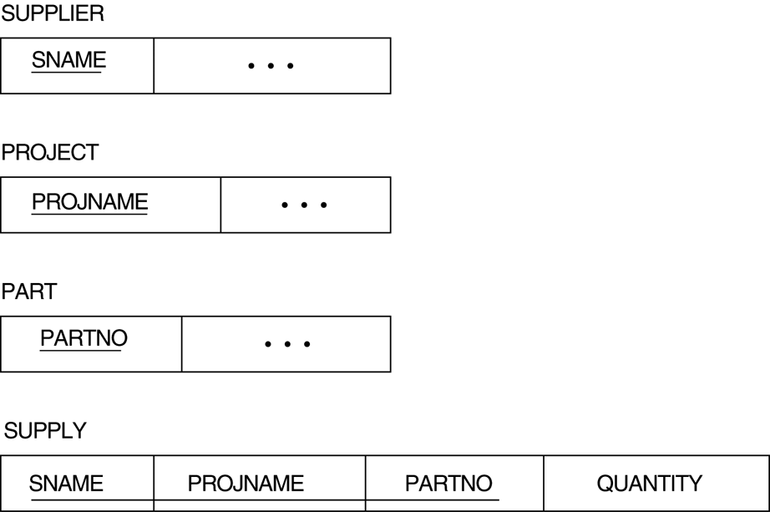
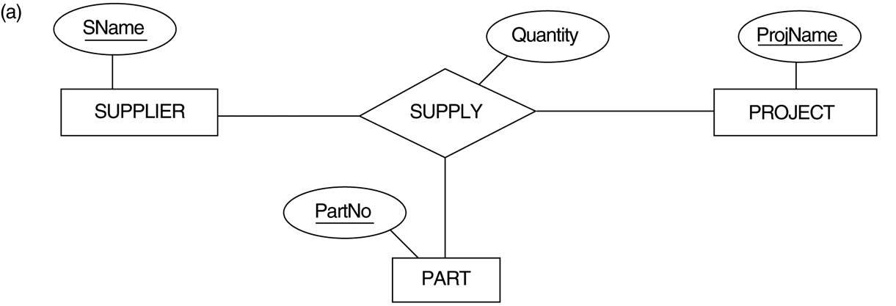
Ternary Relationship Types
The SUPPLY relationship
Mapping The n-ary Relationship Type SUPPLY

Slide 24
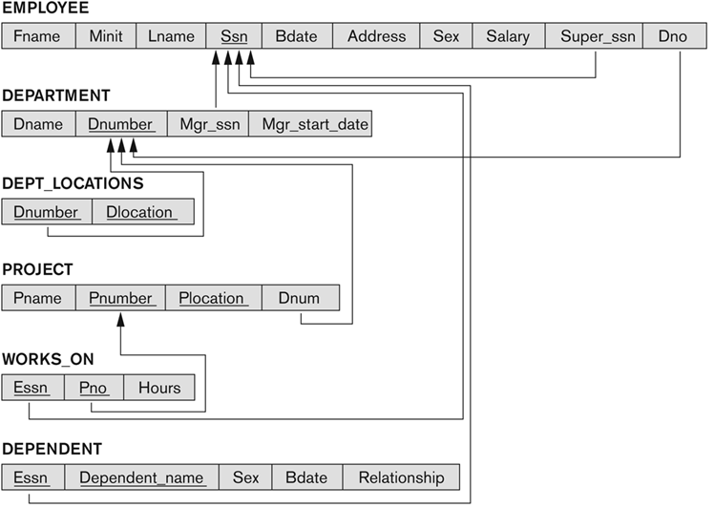
Result of Mapping The COMPANY ER Schema into A Relational Schema

Slide 25
Summary
Showed how a conceptual schema design in the ER model can be mapped to a relational database schema
An algorithm for ER-to-relational mapping was given and illustrated by examples from the COMPANY database
Summarized the correspondences between the ER and relational model constructs and constraints in a table

